Slide 1
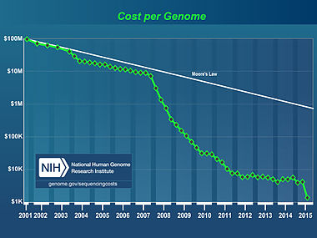
Sequencing is getting cheaper

Slide 2
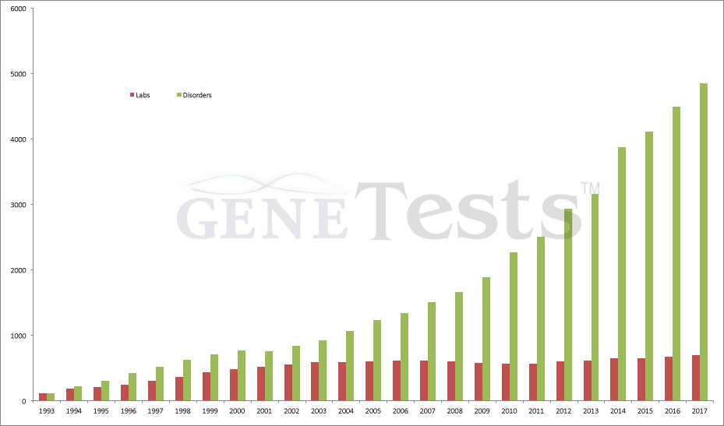
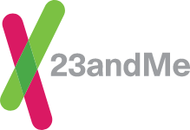
Personal Genome Sequencing
Genetic testing
for disease
- Precision medicine?

Slide 3
Ethical, legal, and social issues?
Health benefits
Social Connections
Privacy issues
Fear of genetic discrimination
Preimplantation genetic diagnosis

Slide 4
Informed Consent and Disclosure
What is my DNA sample being used for?
Does my DNA type tell me anything about my life or health?
Can my data be linked personally to me?
Notes:
There is consensus that a human DNA sample should be obtained only with the willing consent of a donor, who understands the purpose for which it is being collected. Thus, this experiment should be explained ahead of time and students given the option to refrain from participating. (Some teachers may wish to have parents sign a consent form, such as those filled out for a field trip.) There is also consensus that a DNA sample be used only for the express purpose for which it is collected. Thus, student DNA samples should be thrown away after completing the experiment.
The TAS2R38 polymorphism was specifically selected to demonstrate the relationship between genotype and PTC-tasting phenotype, because it has no known relationship to disease states or sex determination.
TAS2R38 alleles are inherited in a Mendelian fashion and can give indications about family relationships.

